Slide 1
Lecture10 Outline
Risk Management and Analysis
  What is risks, what is risks management, Basic approach to risk management, risk identification, Analysis exposure and prioritization, risks control and reduction, contingency plan, monitoring etc
Student: Listen, contribute & prepare a good summary of the lecture.
Independent study: Read the next slide for the next lecture.

Slide 2
Risk Management
What is a Risk?
What is Risk Management?
  A Method for Dealing with Project Risks
    Identification and Handling of Risks
  Can be simple or complex
  On-Going Activity

Slide 3
Risk Management:
Basic Approach
Analysis of Project
  Identification of Risks
For Each Risk:
  Impact and Probability Analysis
    What is the Nature of the Risk?
  Avoidance/Mitigation Plans
    How Can We Minimize the Risk?
  Contingency Plans
    What Do We Do if it Occurs?

Slide 4
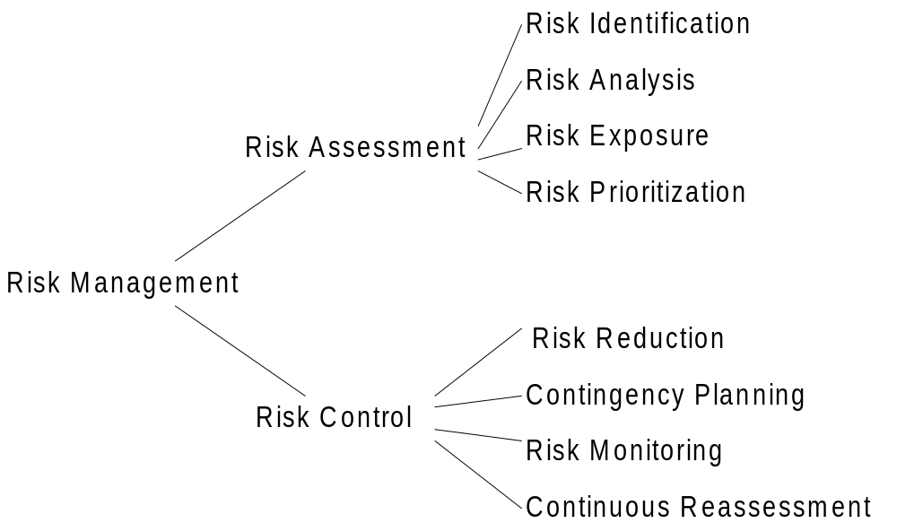
Risk Management

Slide 5
Risk Identification
Risk Identification
  What are the risks?
Risk Identification: Classifications
  Schedule/Cost Risks
  Requirement/Expectation Risks
  Technical Risks

Slide 6
Risk Management: How to Identify Risks
Start with a typical list of software risks
Review development plan
  Critical Paths
  Critical Staff Members
  Critical Vendor Deliveries
  Critical Milestones
Review Requirements
Review Technical Design
Review Past Projects

Slide 7
Risk Management: How to Identify Risks (Continued)
Conduct Risk Brainstorming Sessions with Staff, Users, Vendors, Customers, and Management
  Try to assess the direction of thinking by third parties as they may give an indication of future requirements, expectations, or vendor changes.
  If your dependent on vendors, try to understand their business situation.
Get as much input as possible!

Slide 8
Analysis, Exposure, & Prioritization
For Each Risk:
  Determine Probability of Occurrence
    What is the likelyhood of occurrence?
  Determine Impact
    What is the impact if it occurres?
  Determine Exposure
    What will we lose if the risk occurs?
For All Risks:
  Prioritize
    Where should we put our limited resources?

Slide 9
Analysis, Exposure, Prioritization: How?
Various Techniques Available But Key is Experience
  Individual
  Organizational
Don’t Rely on Just Yourself - Get lots of Inputs

Slide 10
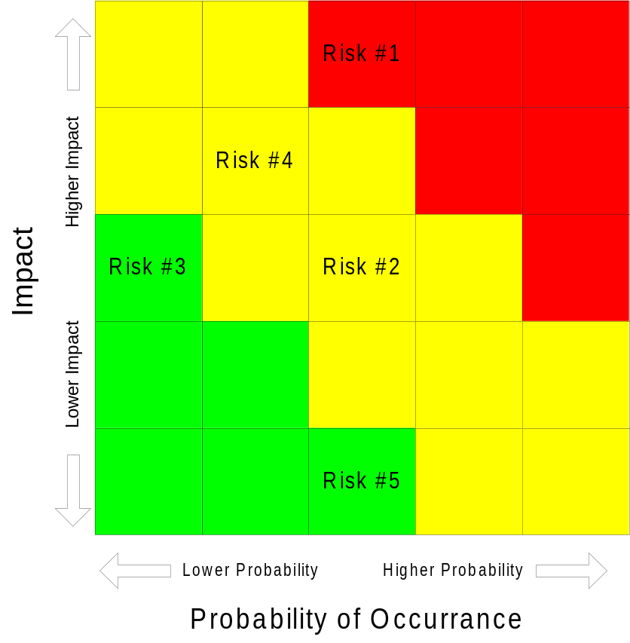
Risk Assessment: A Simple Classification & Tracking Method
Probability of Occurrence vs Impact
  1 to 5 Scale
Priorities
  Red - High
  Yellow - Med
  Green - Low
Review/Present Chart Periodically

Slide 11
Risk Assessment:
Probability Methods
Can we quantitize the risk?
For Each Risk:
  For Each Possible Action:
    Estimate Probability of an Given Outcome P(O)
    Estimate $ Loss of an Given Outcome L(O)
    Multiply the P(O) by L(O) to give $ exposure for the unwanted outcome
  Sum all $ exposures for each Possible Action
  Compare the $ exposures
  Calculate Risk Leverage
    (Risk Exposure Before Reduction - Risk Exposure After Reduction) / (Cost of Risk Reduction)

Slide 12
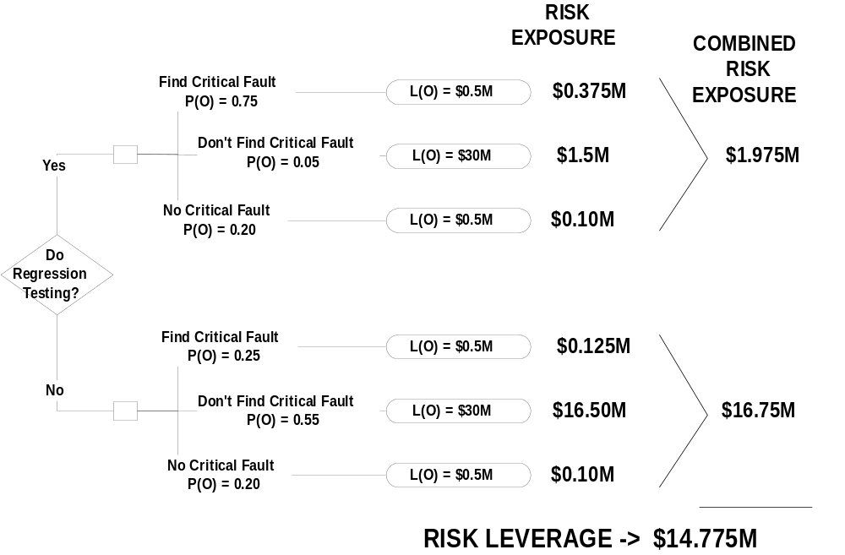
Example Risk Assessment Using Probability Method

Slide 13
Risk Control
Risk Reduction
Contingency Planning
Monitoring
Continuous Reassessment

Slide 14
Risk Reduction
Avoiding Risk
  Modifying project requirements
Transferring the Risk
  By allocation to other systems
  Buying Insurance to cover financial loses
Mitigating the Risk
  Pre-Event Actions to:
    Reduce Likelihood of Occurrence and/or
    Minimize Impact

Slide 15
Contingency Planning
Some risks cannot be reduced
Plan for risk occurrence
Why?
  Reduces “Crisis” atmosphere
  Reduces chance of mistakes
  Reduces time to correct

Slide 16
Risk Management: Monitoring and Continuous Reassessment
Periodic Review of Risk Status
  Changes in Probabilities or Impacts
  Changes in Avoidance/Mitigation/Contingency Plans
Periodic Review of Project to Identify New Risks
Implementation of Risk Avoidance or Mitigation Plans
Keep Management and Customers Informed!!!
  Frequent Risk Reviews

Slide 17
Risk Management: Top 10 Risks
Personnel Shortfalls
  Staffing with Top Talent
  Job Matching
  Team Building
  Morale Building
  Cross-Training
  Pre-scheduling Key People
Software Risk Management: Principles and Practices, B.W. Boehm, IEEE Software, Jan., 1991, pg. 32-41

Slide 18
Risk Management: Top 10 Risks
Unrealistic Schedules and Budgets and/or Underestimating Problem Complexity
  Detailed multisource cost and schedule estimation
  Design to Cost
  Incremental Development
  Software Reuse
  Requirements Scrubbing

Slide 19
Risk Management: Top 10 Risks
Developing the Wrong Software Functions
  Domain Analysis
    (Organizational Analysis/Mission Analysis)
  Operational Concept Formulation
  User Surveys
  Prototyping
  Early User Manuals

Slide 20
Risk Management: Top 10 Risks
Developing the Wrong User Interface
  Prototyping
  Scenerios
  Task Analysis
Gold Plating
  Requirements Scrubbing
  Prototyping
  Cost-Benefit Analysis
  Design to Cost

Slide 21
Risk Management: Top 10 Risks
Continuing Stream of Requirements
  High Change Threshold
  Information Hiding
  Incremental Development
    (defer changes to later increments)

Slide 22
Risk Management: Top 10 Risks
Shortfalls in Externally Performed Tasks
  Reference Checking
  Pre-award Audits
  Award-fee Contracts
  Competitive design or prototyping
  Team Building

Slide 23
Risk Management: Top 10 Risks
Shortfalls in Externally Furnished Components
  Benchmarking
  Inspections
  Reference Checking
  Compatability Analysis
  Examples:
    Compilers
    Development Environments
    Target Hardware

Slide 24
Risk Management: Top 10 Risks
Real-Time Performance Shortfalls
  Simulation
  Benchmarking
  Modeling
  Prototyping
  Instrumentation
  Tuning
  Performance Parameter Allocations

Slide 25
Risk Management: Top 10 Risks
Straining Computer Science Capabilities or Introduction of New Technology to an Organization
  Technical Analysis
  Cost-Benefit Analysis
  Prototyping
  Reference Checking
  Staff Training
  Example:
    Use of a new language, tool, or method

